Slide 1
Efficient Algorithms for the Longest Path Problem
Ryuhei UEHARA (JAIST)
Yushi UNO (Osaka Prefecture University)

Slide 2
The Longest Path Problem
Finding a longest (vertex disjoint) path in a given graph
Motivation (comparing to Hamiltonian path):
  … Approx. Algorithm, Parameterized Complexity
  … More practical/natural
  … More difficult(?)

Slide 3
The Longest Path Problem
Known (hardness) results;
  We cannot find a path of length n-n^{ε} in a given Hamiltonian graph in poly-time unless P=NP [Karger, Motwani, Ramkumar; 1997]
  We can find O(log n) length path [Alon, Yuster, Zwick;1995]
    (⇒O((log n/loglog n)²) [Björklund, Husfeldt; 2003])
  Approx. Alg. achieves O(n/log n) [AYZ95]
    (⇒O(n(loglog n/log n)²)[BH03])
  Exponential algorithm [Monien 1985]

Slide 4
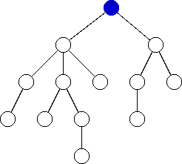
The Longest Path Problem
Known polynomial time algorithm;
Dijkstra’s Alg.(196?)：Linear alg. for finding a longest path in a tree;

Slide 5
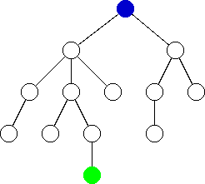
The Longest Path Problem
Known polynomial time algorithm;
Dijkstra’s Alg.(196?)：Linear alg. for finding a longest path in a tree;

Slide 6
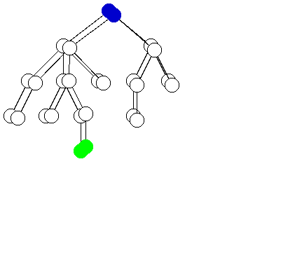
The Longest Path Problem
Known polynomial time algorithm;
Dijkstra’s Alg.(196?)：Linear alg. for finding a longest path in a tree;

Slide 7
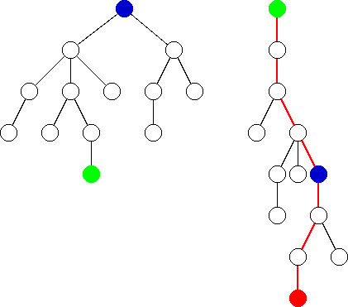
The Longest Path Problem
Known polynomial time algorithm;
Dijkstra’s Alg.(196?)：Linear alg. for finding a longest path in a tree;

Slide 8
Approaches to the Efficient Algs to Longest Path Problem
Extension of the Dijkstra’s algorithm
  Weighted trees (linear), block graphs (linear), cacti (O(n²)).
Graph classes s.t. Hamiltonian Path can be found in poly time
  Some graph classes having interval representations
    (bipartite permutation, interval biconvex graphs)
Dynamic programming to the graph classes that have tree representations (on going)
  Cacti(linear), …
(ISAAC 2004)
(ISAAC 2004)

Slide 9
Approaches to the Efficient Algs to Longest Path Problem
Extension of the Dijkstra’s algorithm
  Weighted trees (linear), block graphs (linear), cacti (O(n²)).
Graph classes s.t. Hamiltonian Path can be found in poly time
  Some graph classes having interval representations
    (bipartite permutation, interval biconvex graphs)
Dynamic programming to the graph classes that have tree representations (on going)
  Cacti(linear), …
(ISAAC 2004)
(ISAAC 2004)

Slide 10
1. Ex of Dijkstra’s Alg
Bulterman et.al. (IPL,2002) showed that
the correctness of Dijkstra’s alg stands for;
  For each u,v,
    length of the shortest path between u and v
    = length of the longest path between u and v
  For each u,v,w,
    d(u,v) ≦ d(u,w) + d(w,v)
  For each u,v,w,
    d(u,v) ＝ d(u,w) + d(w,v) if and only if
    w is on the unique path between u and v

Slide 11
1. Ex of Dijkstra’s Alg
Construct G’=(V’,E’) from G=(V,E) s.t.：
  V⊆V’
  For each u,v∈V,
    length of the shortest path between u,v on G’
    = length of the longest path between u,v on G
  For each u,v∈V,
    the shortest path between u,v on G’ is unique

Slide 12
1. Ex of Dijkstra’s Alg
Theorem: ExDijkstra finds a longest path if G and G’ satisfy the conditions.
ExDijkstra: G=(V,E) and G’=(V’,E’)
  pick any vertex w in V;
  find x∈V with max{d(w,x)} on G’;
  find y∈V with max{d(x,y)} on G’;
  x and y are the endpoints of the longest path in G, and d(x,y) on G’ is its length.

Slide 13
1. Ex of Dijkstra’s Alg (Summary)
Theorem: Vertex/edge weighted tree (linear)
Theorem: Block graph (O(|V|+|E|))
Theorem: Cactus (O(|V|2))

Slide 14
1. Ex of Dijkstra’s Alg (Cacti)
Cactus:
Each block is a cycle
Two cycle share at most one vertex which is a separator
G
G’
cactus
The longest path between
u and v on G
The shortest path between
u and v on G’
=

Slide 15
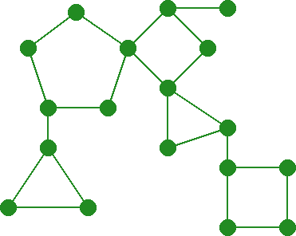
1. Ex of Dijkstra’s Alg (Cacti)
Sample

Slide 16
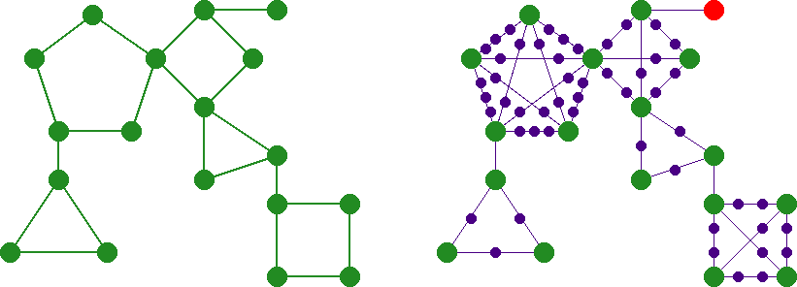
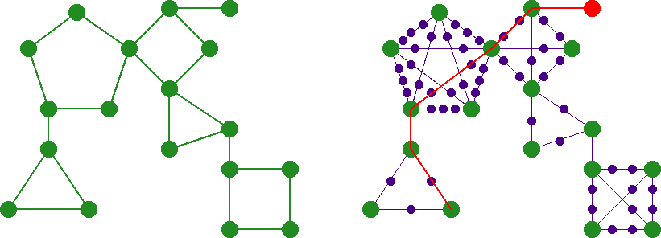
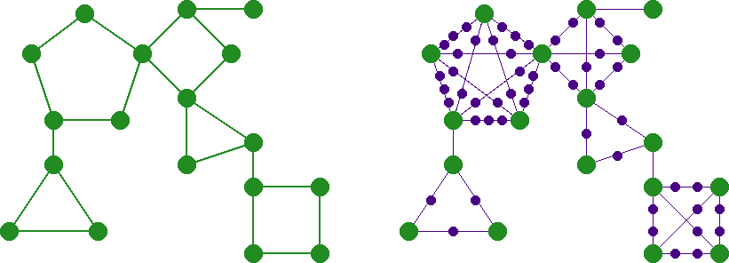
1. Ex of Dijkstra’s Alg (Cacti)
Sample

Slide 17
1. Ex of Dijkstra’s Alg (Cacti)
Sample

Slide 18
1. Ex of Dijkstra’s Alg (Cacti)
Sample

Slide 19
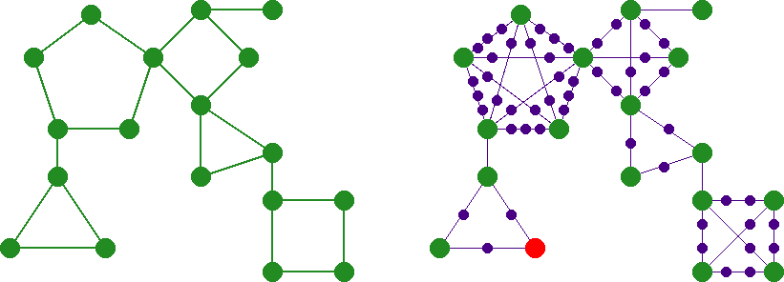
1. Ex of Dijkstra’s Alg (Cacti)
Sample

Slide 20
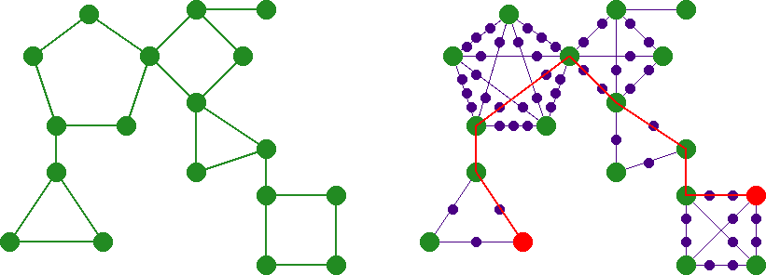
1. Ex of Dijkstra’s Alg (Cacti)
Sample

Slide 21
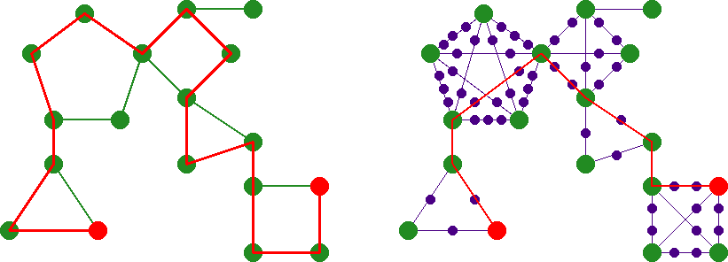
1. Ex of Dijkstra’s Alg (Cacti)
Sample

Slide 22
Graph classes s.t. Hamiltonian
Path can be found in poly time
Fact 1:
  Hamiltonian Path is NP-hard on a chordal graph. (In fact, strongly chordal split graph[Müller,1997].)
Fact 2:
  Hamiltonian Path is solvable on an interval graph in linear time. [Damaschke, 1993].
Our goal:
  Poly-time algorithm for Longest Path on an interval graph.

Slide 23
Interval Graphs
An interval graph G=(V,E) has an interval representation s.t. {u,v}∈E iff I_{u}∩I_{v}≠φ

Slide 24
Interval Graphs
An interval graph G=(V,E) has an interval representation s.t. {u,v}∈E iff I_{u}∩I_{v}≠φ
I_{v}
v
I_{u}
Hamiltonian Path: linear time solvable.
u
Longest Path: ????
⇒ Restricted interval graphs…

Slide 25
Restricted Interval Graphs
An interval biconvex graph G=(S∪Y,E) has an interval representation s.t…
Y: biconvex
s₁
s₃
s₆
s₈
s₂
s₄
s₇
s₅
S: integer points

Slide 26
Restricted Interval Graphs
Interval biconvex graph G=(S∪Y,E) is introduced [Uehara, Uno; 2004] from graph theoretical viewpoints;
    Natural analogy of biconvex graphs (bipartite graph class)
    Generalization of proper interval graphs
    Generalization of threshold graphs
    Best possible class longest path can be found in poly time…

Slide 27
Poly-time alg for longest path on an interval biconvex graph (idea)
  Find the trivial longest path P on G[Y];
  Embed the vertices in S into P as possible;
  Adjust endpoints if necessary.
3
4
3
7
1
9
2
3
8
8
30

Slide 28
Poly-time alg for longest path on an interval biconvex graph (idea)
  Find the trivial longest path P on G[Y];
  Embed the vertices in S into P as possible;
  Adjust endpoints if necessary.
3
4
3
7
1
9
2
3
8
8
30

Slide 29
Poly-time alg for longest path on an interval biconvex graph (idea)
  Find the trivial longest path P on G[Y];
  Embed the vertices in S into P as possible;
  Adjust endpoints if necessary.
3
4
7
9
8
8
3
4
3
7
1
9
2
3
8
8
30

Slide 30
Poly-time alg for longest path on an interval biconvex graph (idea)
  Find the trivial longest path P on G[Y];
  Embed the vertices in S into P as possible;
  Adjust endpoints if necessary.
3
4
7
9
8
30
3
4
3
7
1
9
2
3
8
8
30

Slide 31
Poly-time alg for longest path on an interval biconvex graph (idea)
  Find the trivial longest path P on G[Y];
  Embed the vertices in S into P as possible;
  Adjust endpoints if necessary.
3
How can we determine the vertices in S?
Where do we embed them?
4
7
9
8
30
3
4
3
7
1
9
2
3
8
8
30

Slide 32
Poly-time alg for longest path on an interval biconvex graph (idea)
  Embed the vertices in S into P as possible;
w(e) is the number at the right-endpoint
3
4
3
7
1
9
2
3
8
8
30
3
4
3
7
1
9
2
3
8
8
30

Slide 33
Poly-time alg for longest path on an interval biconvex graph (idea)
  Embed the vertices in S into P as possible;
w(e) is the number at the right-endpoint
3
4
3
7
1
9
2
3
8
8
30
3
4
3
7
1
9
2
3
8
8
30
Find the maximum weighted matching!!

Slide 34
Open Problems
Longest Path on an interval graph??
  Combination of DP/Dijkstra and weighted maximum matching on MPQ-tree representation?
  Related to the following open problem?
    Hamiltonian Path with a start point on an interval graph? [Damaschke, 1993].
Extension to
  Longest cycle on some graph classes
  Hamiltonian cycle/path on some graph classes

